Slide 1
Meetup
Websocket
Stream API
Stream
Kafka
S3
(Raw)
Store
Stream
Spark Stream
Spark
ML/EDA
Stream via Kafka
Apply
Structure
plotly
S3
(3NF)
Synthesize
Show
Flask

Slide 2
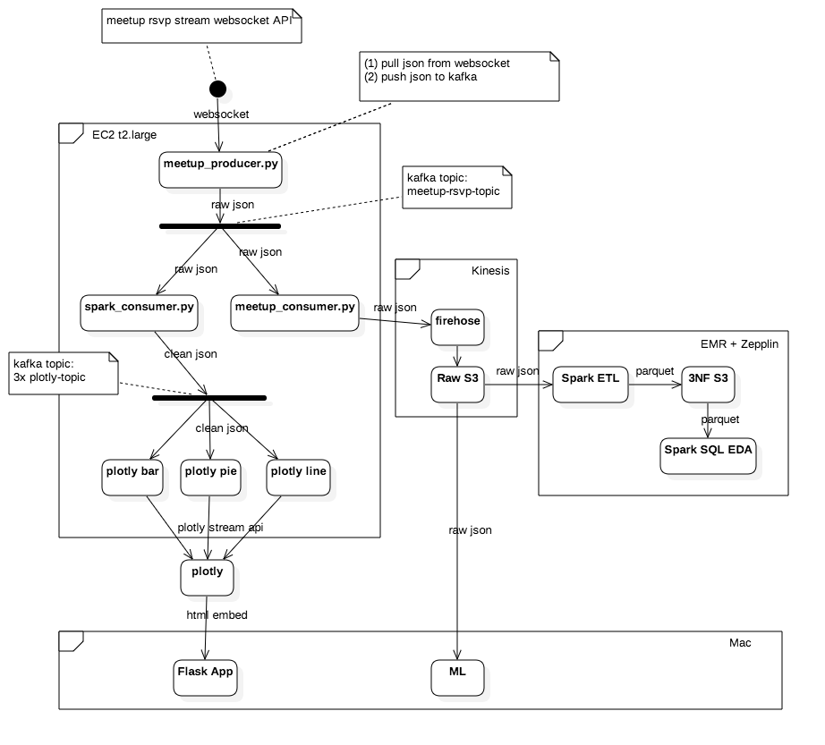
Stream
Structure
Store
Synthesize
Future
Show

Slide 3
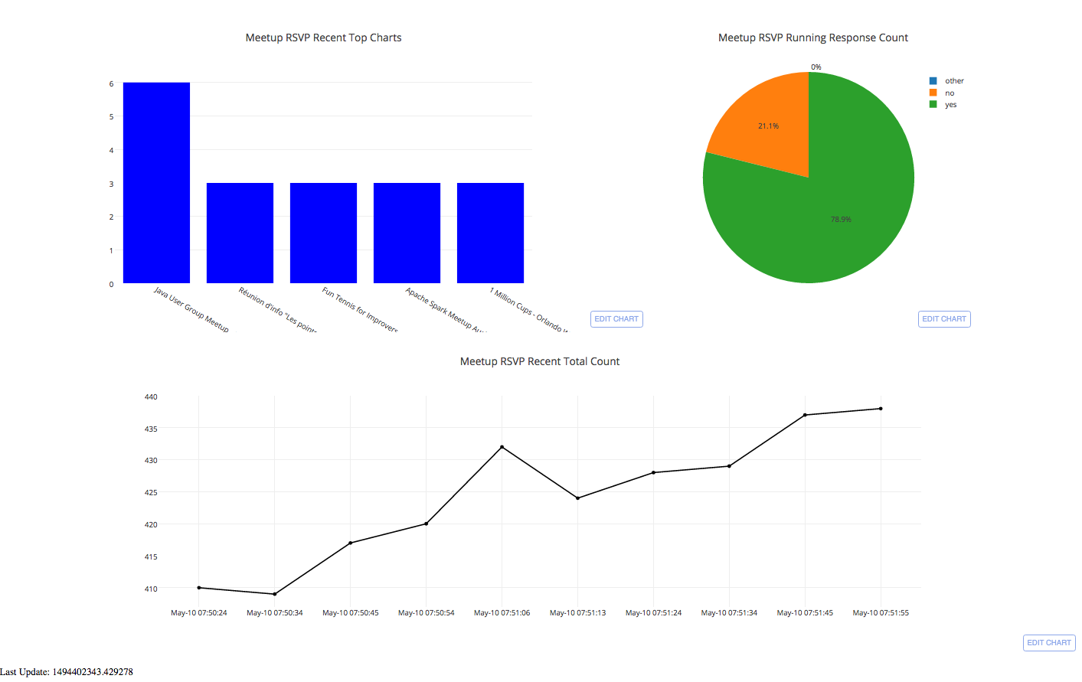
Recent 5min Most Popular Groups
(order by rsvp=yes count), 3 sec refresh
Running Sum of rsvp=yes and rsvp=no counts, 3 sec refresh
Recent 5min Total Response Count, 1 sec refresh

